Slide 1


The Infernos

Slide 2
Our Team
Georgi
Trendafilov
Georgi
Vasilev
Stanimir
Dimitrov
Boris
Simeonov
Scrum Trainer
QA Engineer
Front-end Developer
Back-end Developer

Slide 3
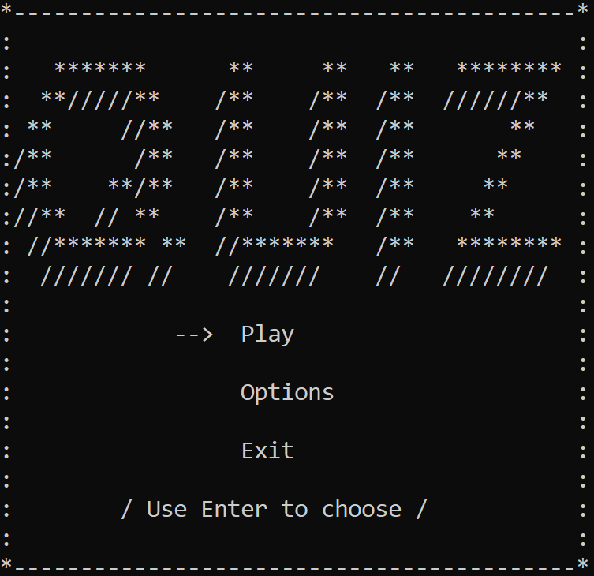
About our project

Slide 4
Stages of work
01
02
03
04
organization
idea
realization
& test
present

Slide 5







Used technologies

Slide 6
Now, to the code

